Slide 1

SRI VENKATAESHWARA COLLEGE OF ENGINEERING AND TECHNOLOGY (AUTONOMOUS)
R.V.S Nagar, Chittoor – 517 127. (A.P)
Department of CSE(AI&ML)
Project Title:
Hybrid Product Recommendation System for E-Commerce Platform
Student’s name’s : T. Rajesh (22781A33C5)
K. Ugeswar (23785A3309)
V. Sandhya (22781A33E0) Guide:
Rishi Kumar (22781A33F3) DR.G. KAVITHA

Slide 2
AGENDA:
INTRODUCTION
ABSTRACT
LITERATURE SURVEY
EXISTING SYSTEM
DRAWBACKS IN EXISTING SYSTEM
PROPOSED SYSTEM
MODULE & MODULE DESCRIPTION
FUTURE SCOPE
CONCLUSION

Slide 3
1. INTRODUCTION:
Online platforms today offer an overwhelming number of products, yet users continue to struggle with finding items that truly match their preferences and needs. Despite advances in data analytics and machine learning, product discovery is still affected by guesswork, irrelevant suggestions, and delayed personalization. Many users rely on generic recommendations or manual searches, often after spending significant time navigating unsuitable options. The current recommendation approaches lack precision, adaptability, and contextual understanding. Suggestions are frequently reactive, poorly personalized, and disconnected from real user behavior. This not only reduces user satisfaction and engagement but also impacts business performance and customer retention. It is clear that there is a critical need for intelligent, user-centric recommendation systems that can understand user preferences early, adapt dynamically, and deliver accurate, personalized product suggestions users can trust.

Slide 4
2. ABSTRACT :
To address the challenge of information overload in online platforms, we developed an intelligent product recommendation system that analyzes user interactions to deliver personalized suggestions. Using machine learning techniques, the system identifies user preferences, predicts relevant products, and ranks recommendations accordingly. Based on user behavior and product features, it generates accurate and meaningful recommendations in real time. The platform integrates collaborative filtering, content-based analysis, data preprocessing, and a user-friendly interface, making product discovery efficient, scalable, and user-centric.

Slide 5
4.LITERATURE SURVEY :
Title | Year | Technologies Used | Demerits / Limitations
Ordered Clustering-based Algorithm (OCA) for E-commerce Recommendation Systems – Gulzar et al. | 2022 | Collaborative Filtering, Ordered Clustering Algorithm (OCA), User Similarity Analysis | Performance depends on the quality of similarity measures and may struggle with highly dynamic user behavior.
Product Recommendation System for E-commerce using Neural Collaborative Filtering and Hybrid Methods – Ilyes | 2023 | Hybrid Recommendation Models, Pattern Recognition | Increased computational complexity and higher training time due to hybrid and neural models.
Machine Learning-based E-commerce Product Recommendation System – Rahman, Haque & Ahmad | 2024 | Gaussian Naive Bayes, Decision Tree, Random Forest, Logistic Regression, PCA | Requires careful feature selection and parameter tuning; scalability can be challenging for very large datasets.
Hybrid E-commerce Recommendation System using K-Means and Case-Based Reasoning – Wattimena & Rofi’i | 2025 | K-Means Clustering, Case-Based Reasoning (CBR), Hybrid Recommendation Approach | Effectiveness depends on the availability of relevant past cases; limited adaptability to new users (cold-start).

Slide 6
HARDWARE AND SOFTWARE REQUIREMENTS :
Hardware Requirements
Processor: Intel Core i5 / i7 or AMD Ryzen 5 / 7
RAM: Minimum 8 GB (16 GB recommended for better performance)
Storage: At least 20–50 GB free disk space
GPU (Optional): NVIDIA GPU (for faster model training on large datasets)
Internet: Required for data access and deployment
Software Requirements
Operating System: Windows 10/11, Ubuntu 20.04+, or macOS
Programming Language: Python 3.8 or above
Libraries & Frameworks:
  NumPy, Pandas (data processing)
  Scikit-learn (machine learning)
  Surprise (collaborative filtering)
  Matplotlib / Seaborn (visualization)
Web Framework (Optional): Flask / Django
Development Tools: VS Code / Jupyter Notebook
Database (Optional): MySQL / MongoDB

Slide 7
4. Existing System:
product recommendations are mostly generated using basic and generalized techniques such as popular products, top-rated items, or recently viewed products.
These recommendation methods do not fully consider individual user preferences, browsing behavior, or purchase history, resulting in limited personalization.
The lack of advanced machine learning and hybrid recommendation techniques limits their ability to capture complex user interest

Slide 8
5. EXISTING SYSTEM DRAWBACKS:
Provides generic recommendations same for all users
Lacks personalization based on user preferences and behavior
Difficult to handle large volumes of user data efficiently
Poor product discovery for new or niche items
Limited accuracy in predicting user interests

Slide 9
5. PROPOSED SYSTEM:
Our proposed system leverages advanced machine learning techniques to provide an efficient, scalable, and user-centric solution for product recommendation. It employs a hybrid recommendation approach that combines collaborative filtering and content-based filtering to capture both user behavior patterns and product characteristics. The system processes user–item interaction data through structured preprocessing steps, including data cleaning and transformation, to ensure high-quality inputs for model training.
By integrating multiple recommendation models and evaluating them using standard performance metrics, the system selects the best-performing model to generate accurate and personalized product suggestions. This hybrid approach effectively addresses challenges such as data sparsity and cold-start problems, enabling reliable recommendations even with limited user history and ensuring improved user experience and decision-making.

Slide 10

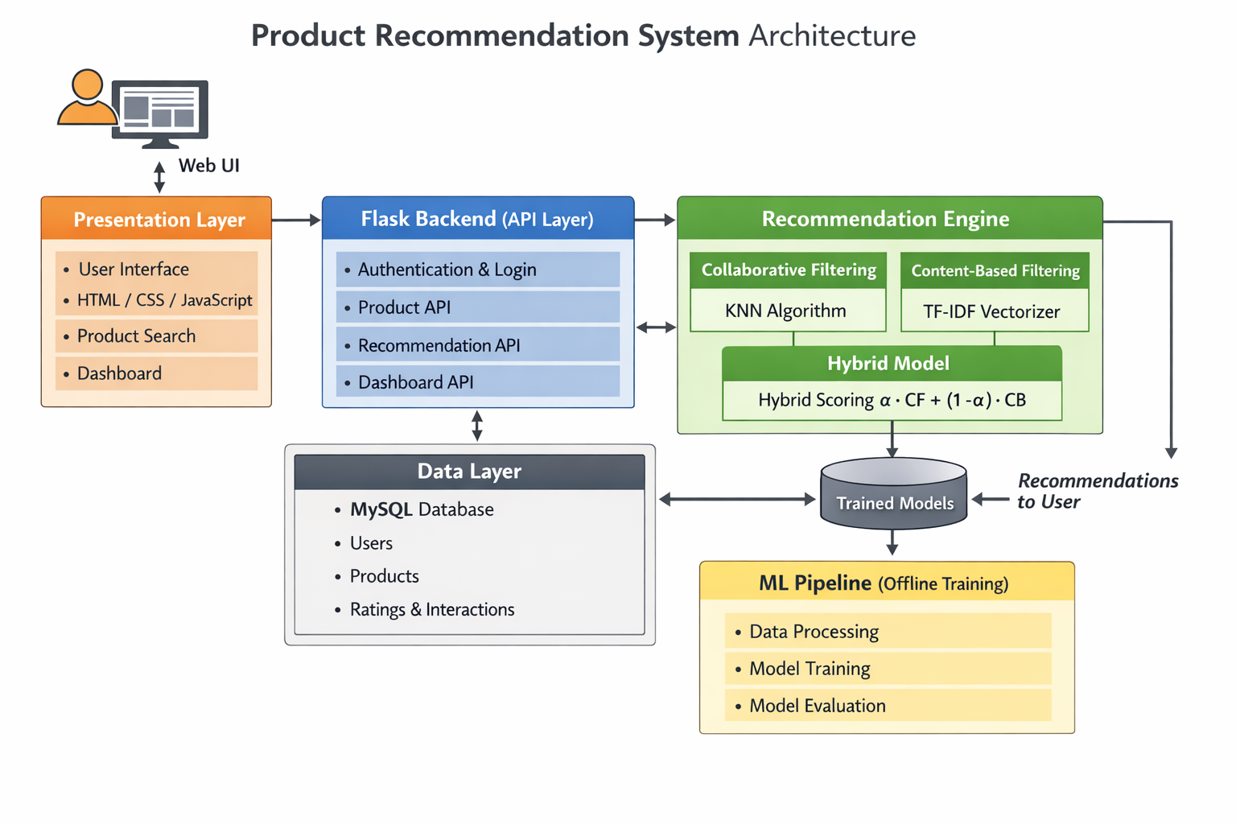
Architecture:

Slide 11
7. MODULE DESCRIPTION :
1. Presentation Layer (Web UI)
This module provides the user-facing interface of the system. It allows users to register, log in, search for products, view recommendations, and interact with the platform through a responsive dashboard built using HTML, CSS, and JavaScript.
2. Flask Backend (API Layer)
The backend module acts as a bridge between the user interface, database, and recommendation engine. It handles user authentication, manages product and recommendation APIs, processes user requests, and delivers personalized recommendations to the frontend securely and efficiently.
3. Data Layer
This module stores and manages all system data using a MySQL database. It maintains user details, product information, ratings, and user–item interaction history, which are essential for training models and generating accurate recommendations.

Slide 12
4. Recommendation Engine
The core intelligence of the system resides in this module. It implements collaborative filtering using the KNN algorithm to analyze user–item interactions and content-based filtering using TF-IDF vectorization to analyze product features. A hybrid model combines both approaches to generate more accurate and personalized recommendations.
5. Hybrid Scoring Module
This module combines the outputs of collaborative filtering and content-based filtering using a weighted hybrid scoring function. By balancing both techniques, it reduces cold-start and data sparsity issues while improving overall recommendation accuracy.
6. ML Pipeline (Offline Training)
This module is responsible for offline data preprocessing, model training, and evaluation. It processes historical data, trains multiple models, evaluates their performance using standard metrics, and stores the best-performing trained models for real-time recommendation generation.

Slide 13
7. Trained Models Repository
This module stores the trained machine learning models used by the recommendation engine. These models are loaded during runtime to generate fast and reliable recommendations for users.

Slide 14
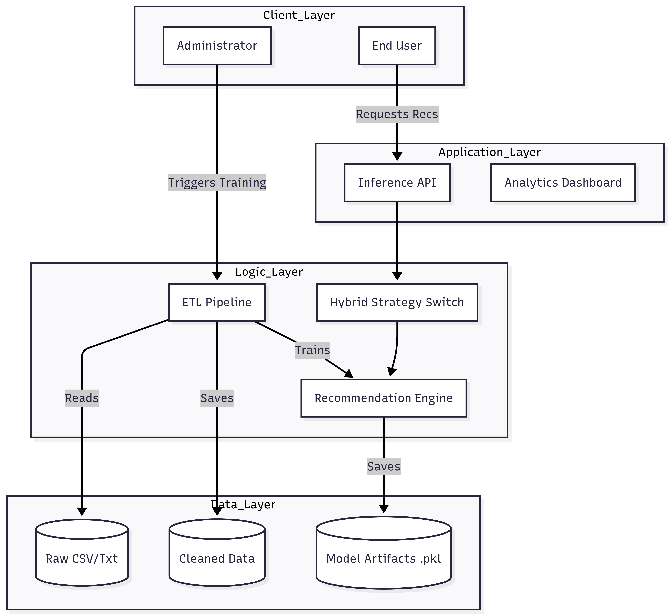

Slide 15
ALGORITHM:
Data Initialization: Load user-item interaction matrices and product metadata into system memory.
Feature Extraction: Concatenate product attributes (Name, Category) to form a unified text representation for each item.
Vectorization (TF-IDF): Convert text features into numerical vectors using Term Frequency-Inverse Document Frequency to weigh unique terms.
Content Similarity Calculation: Compute the Cosine Similarity between the active product's vector and all other product vectors to find matches.
User Neighborhood Identification: Identify the 'k' users with the most similar rating history to the active user using the KNNBasic algorithm.
Rating Prediction: Estimate the rating the active user would assign to candidate products based on the weighted average of neighbors' ratings.

Slide 16
7.Score Normalization: Scale the predicted collaborative ratings (1-5 stars) to a 0-1 range to ensure mathematical compatibility with content scores.
8.Hybrid Fusion: Calculate the final relevance score by combining Collaborative and Content scores using a linear weighted formula (alpha).
9.Cold Start Handling: Automatically bypass collaborative filtering and rely solely on content similarity if sufficient user history is missing.
10.Final Ranking: Sort all candidate products by their calculated hybrid score in descending order and return the top N recommendations.

Slide 17
IMPLEMENTATION & EXECUTION:
Frontend developed using HTML, CSS, and JavaScript
Backend implemented using Flask for API handling
MySQL used to store user, product, and interaction data
Recommendation engine implemented using TF-IDF and KNN
Hybrid model combines content-based and collaborative results
ML models trained using historical data
System executes recommendations in real time for users

Slide 18
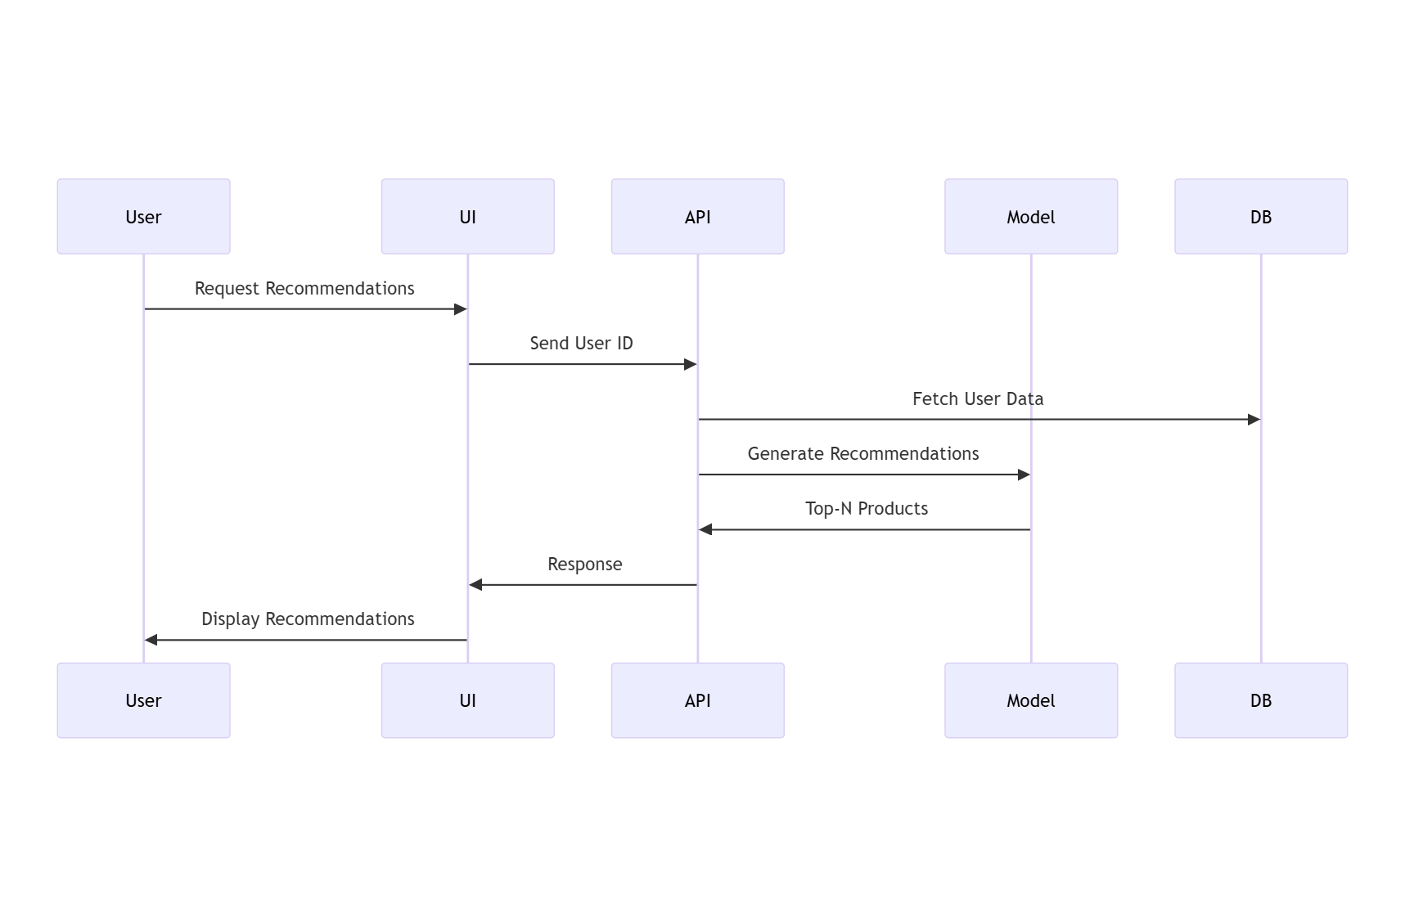

Slide 19
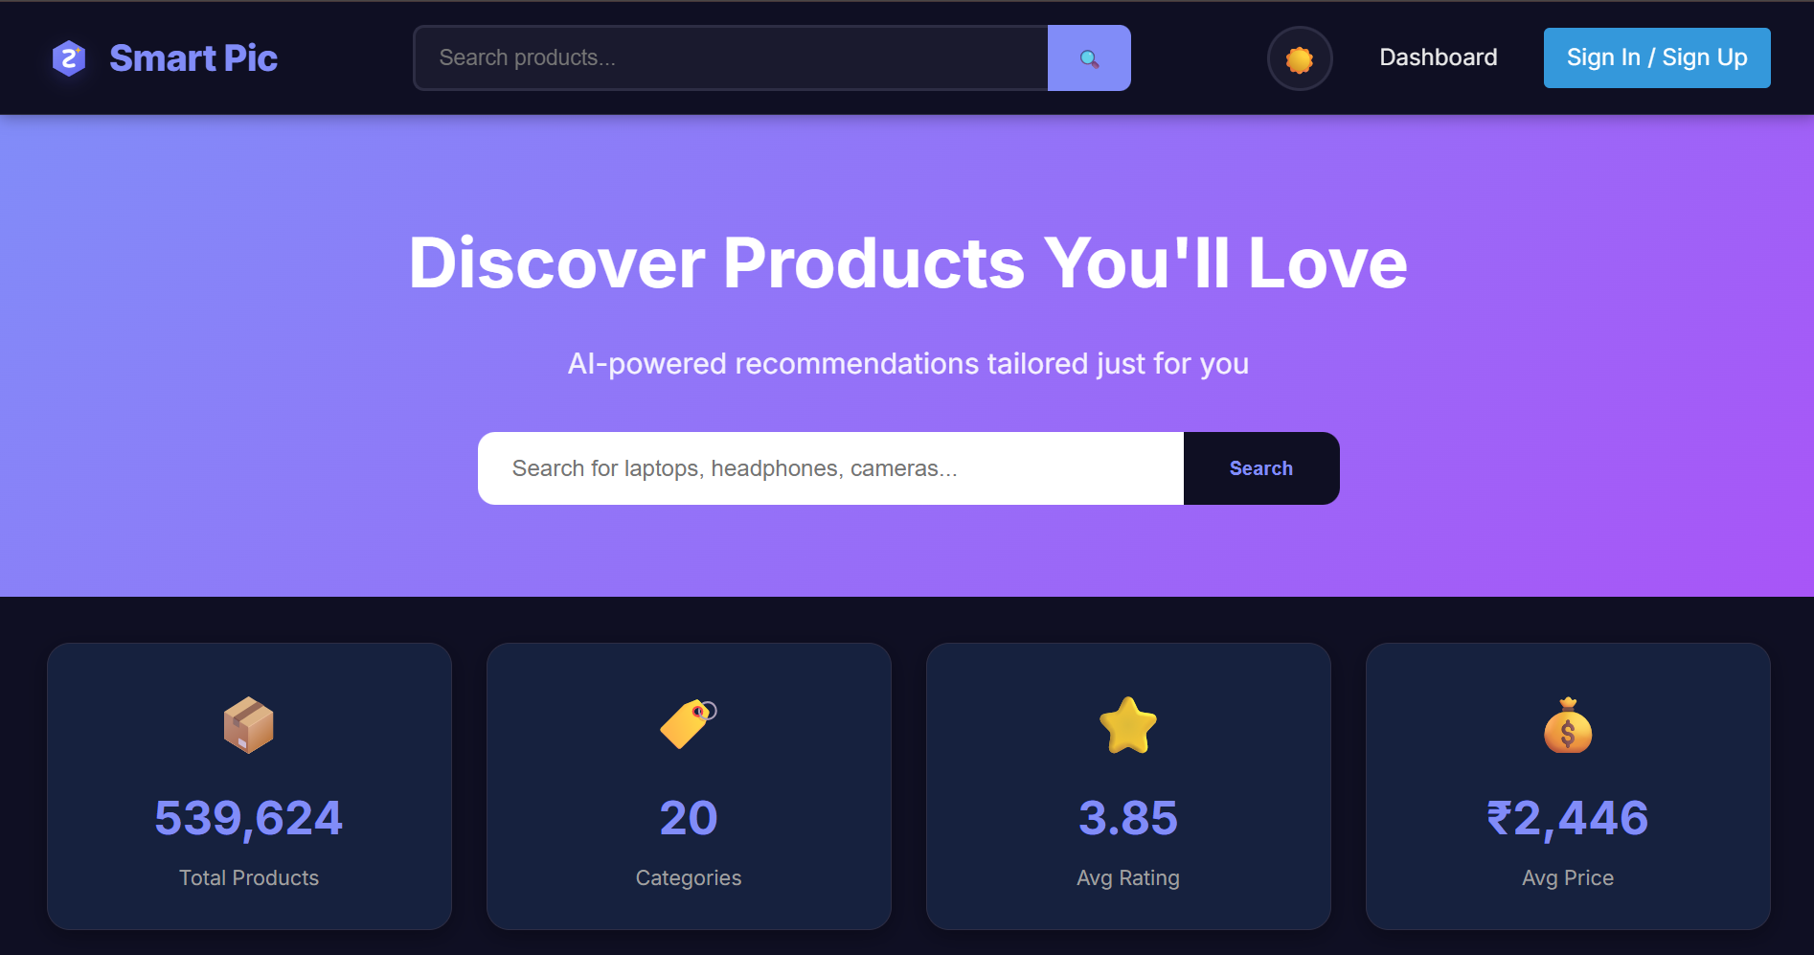
OUTPUT SCREENSHOTS

Slide 20
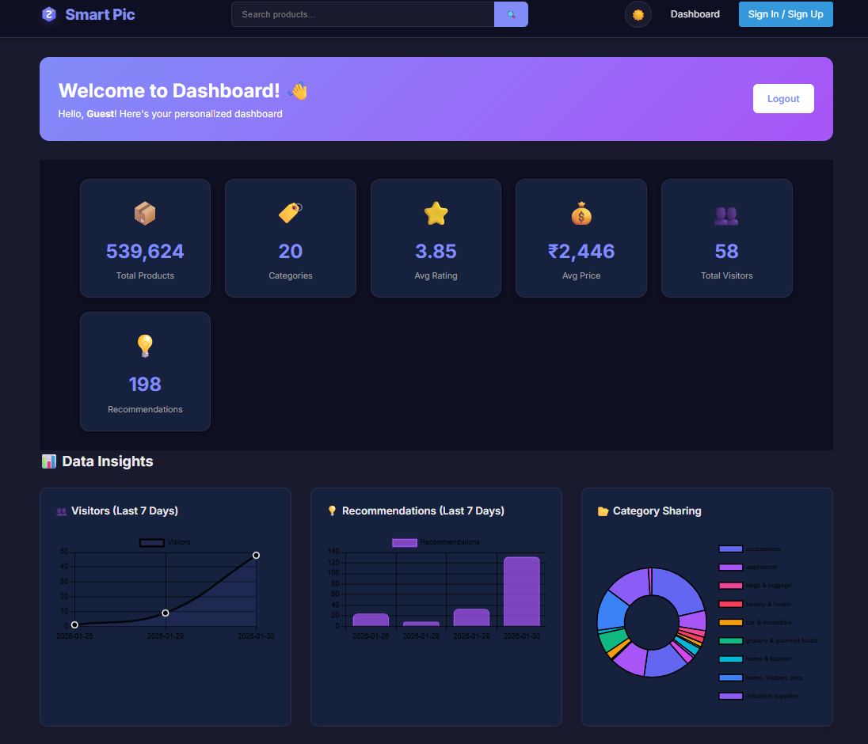

Slide 21
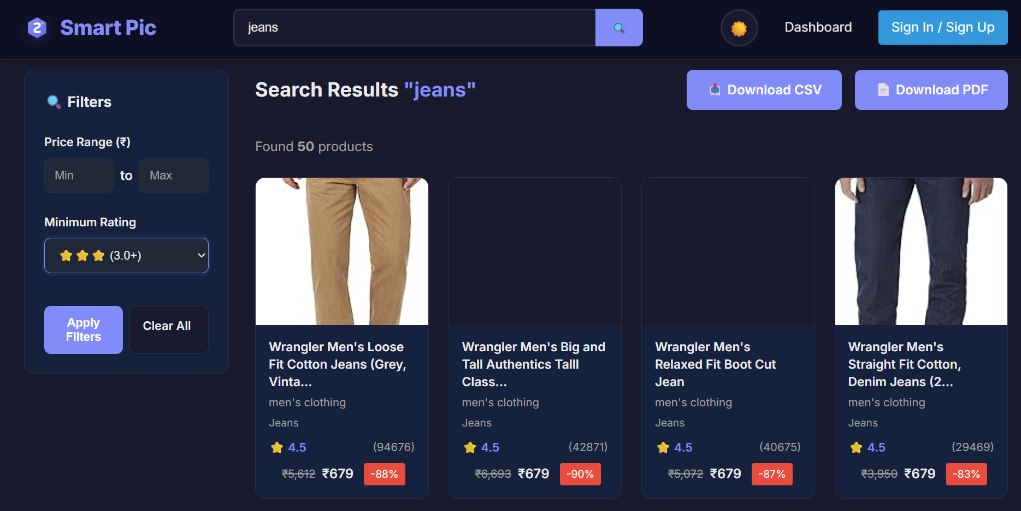

Slide 22
8. FUTURE SCOPE :
The system can be extended to support cross-platform recommendations, including mobile applications and web platforms.
The system can be personalized further using user demographic data while ensuring privacy and security.
Advanced hybrid recommendation models combining collaborative, content-based, and knowledge-based approaches can be implemented.
Advanced hybrid recommendation models combining collaborative, content-based, and knowledge-based approaches can be implemented.
The recommendation system can be expanded to support voice-based and chatbot-driven recommendations.

Slide 23
9. CONCLUSION :
The Recommendation System successfully demonstrates that a Hybrid Approach—combining the behavioral insights of Collaborative Filtering (KNN) with the specificity of Content-Based Filtering (TF-IDF)—significantly outperforms single-method strategies in e-commerce environments.
By mitigating the "Cold Start" problem and leveraging an $\alpha$-weighted ensemble algorithm, the system achieved a highly accurate RMSE of 0.611, ensuring relevant suggestions for both new and returning users.
The integration of this intelligent engine into a scalable Flask web application, complete with real-time analytics and a responsive dashboard, proves that advanced machine learning can be effectively deployed to enhance user discovery, reduce choice overload, and potentially drive higher conversion rates in modern digital marketplaces.

Slide 24
REFERENCES:
Shankar, A., Perumal, P., Subramanian, M., Ramu, N., Natesan, D., Kulkarni, V. R., & Stephan, T. (2024). An intelligent recommendation system in e-commerce using ensemble learning. Multimedia Tools and Applications, 83(16), 48521-48537
Gulnara, B., Guldana, S., & Yerassyl, A. (2024). Application of Recommended Systems for E-commerce. Procedia Computer Science, 231, 329-334.
Ilyes, H. (2024). Product Recommendation System for E-Commerce (Doctoral dissertation, UNIVERSITY OF BISKRA).
Wang, S., & Wu, C. (2024). Research on personalized recommendation system of e-commerce based on big data. Front. Soc. Sci. Technol, 6(5), 165-168..

Slide 25
Thank You

